Slide 1
Project Presentation of Exploratory Project (EP)
On
A Fault-Tolerant and Scalable Micro-services Framework for Real-Time Digital Payment Processing
Sai Krishna
2210992215
Yankit Kumar 2210992552
Amrit Pal Singh
2210991255
Supervised By
Dr. Anshu Singla
Department of Computer Science and Engineering,
Chitkara University, Punjab

Slide 2
Problem Background
Traditional monolithic payment systems cannot scale efficiently and often cause system-wide failures during peak usage.
Modern users expect instant, error-free digital transactions.
Payment systems must handle 1 million+ concurrent transactions while maintaining constant availability and reliability.

Slide 3
Objective of the Project
Develop a scalable and fault-tolerant digital payment processing framework.
Ensure service continuity and fast recovery from system failures
Improve transaction throughput and reduce latency in real-time processing.
Provide a blueprint for modern financial systems handling high-volume digital payments.

Slide 4

Proposed Solution / System Overview
A micro-services-based framework ensures modularity, scalability, and fault isolation.
Core Components
API Gateway: Handles authentication, rate-limiting, and routing.
Authentication Service: Manages user identity and tokens.
Transaction Processor: Validates and executes payment operations.
Fraud Detection: Uses AI models for real-time risk scoring.
Notification Service: Handles alerts and confirmations.
Ledger Service: Maintains immutable transaction records.

Slide 5
Key Features
Service Isolation: Independent micro-services prevent cascading failures.
Independent Scaling: Each service scales separately based on demand.
Parallel Development: Teams can work on separate services simultaneously.
Reliable Messaging (Kafka): Ensures message delivery even during failures.
Saga Pattern: Coordinates distributed transactions and rollbacks.

Slide 6
Fault Tolerance Mechanisms
Service Isolation – Deployments are independent, reducing blast radius during failures.
Circuit Breaker Pattern – Automatically halts calls to failing services and provides fallback responses.
Apache Kafka Messaging – Guarantees message persistence and recovery.
Saga Choreography – Enables consistency across distributed transactions.

Slide 7
Scalability Mechanisms
Kubernetes Auto-Scaling: Increases replicas dynamically based on CPU/memory metrics.
Multi-Layer Load Balancing: Balances requests at both gateway and consumer group levels.
Redis Distributed Caching: Reduces latency and database load for frequent lookups.

Slide 8
Performance Evaluation
8.9× Throughput Improvement: 87,000 TPS achieved vs monolith’s 9,800 TPS limit.
68.4% Latency Reduction: P99 latency dropped from 980 ms → 310 ms.
250+ Additional Uptime Hours: Measurable annual enhancement per service.

Slide 9
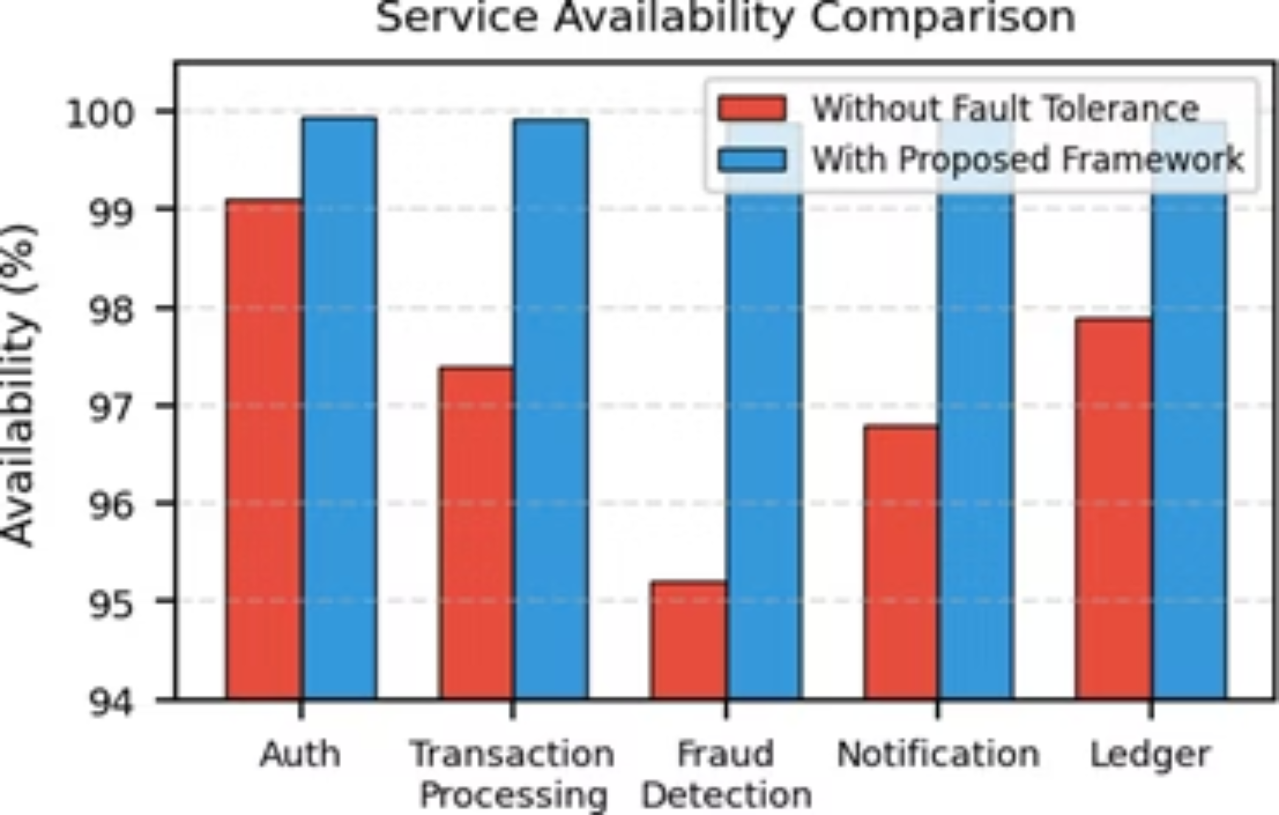
Availability Comparison
All services achieve 99.88%+ availability with framework vs 95.2% minimum without.

Slide 10
Availability and Resilience
Availability: 99.88%+ uptime across services vs 95.2% minimum in monolith.
Resilience Under Failure:
97.3% transaction success under 30% failure injection.
31.6× faster recovery with circuit breaker.
99.9% overall system uptime.

Slide 11
Key Findings
Balanced Architecture: Fault tolerance and scalability must co-evolve as design equals.
Risk of Isolated Scaling: Purely scaling systems can increase fragility without fault tolerance.
Production-Ready Framework: Provides realistic patterns for fintech teams upgrading digital payment systems.

Slide 12
Thank You

